Slide 1
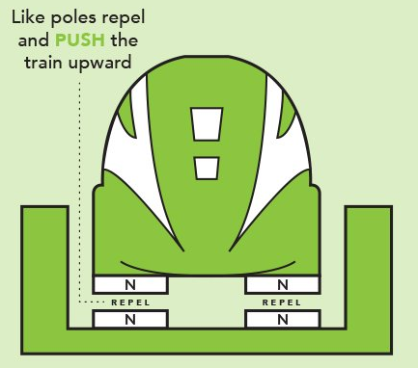
Daily Review
CFU 1
Which method of friction reduction is being used?
In situations where friction is reduced, you need to:
Identify which method is being used.
Explain how friction is being reduced in that situation.
This is an example of levitation. The magnets push the train up, eliminating its contact with the rails.
CFU 2
How does this method work in this situation?
Reminders:
Lubrication makes things slippery Balls and rollers make things roll, which produces less friction than pushing or sliding Levitation reduces contact between surface Streamlined objects are smooth and rounded

Slide 2
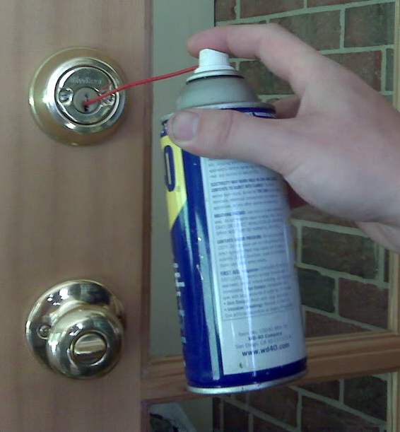
Daily Review
CFU 1
Which method of friction reduction is being used?
In situations where friction is reduced, you need to:
Identify which method is being used.
Explain how friction is being reduced in that situation.
This is an example of lubrication. The oil makes the parts of the lock slippery, allowing them to move more easily.
CFU 2
How does this method work in this situation?
Reminders:
Lubrication makes things slippery Balls and rollers make things roll, which produces less friction than pushing or sliding Levitation reduces contact between surface Streamlined objects are smooth and rounded

Slide 3
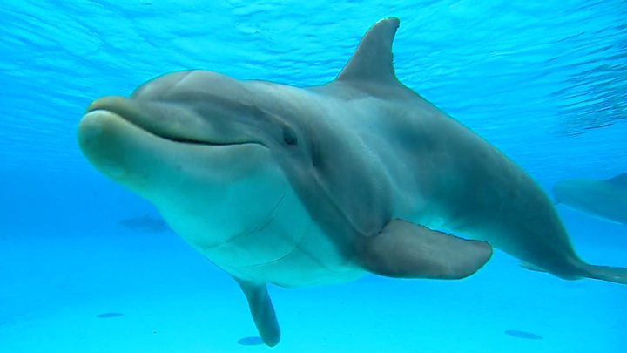
Daily Review
CFU 1
Which method of friction reduction is being used?
In situations where friction is reduced, you need to:
Identify which method is being used.
Explain how friction is being reduced in that situation.
This is an example of streamlining. The dolphin’s body is smooth and rounded, reducing its friction with the water.
CFU 2
How does this method work in this situation?
Reminders:
Lubrication makes things slippery Balls and rollers make things roll, which produces less friction than pushing or sliding Levitation reduces contact between surface Streamlined objects are smooth and rounded

Slide 4
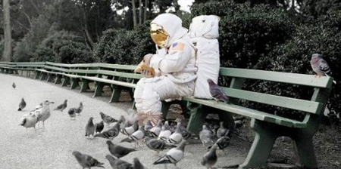
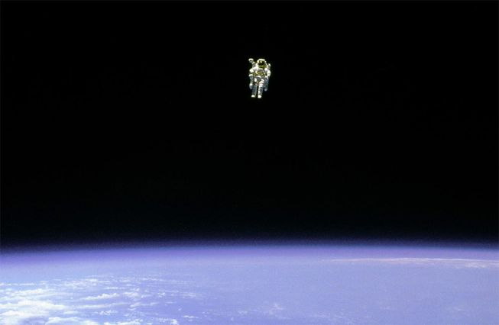
Daily Review
CFU 1
Is the mass of the two objects different?
Comparing Gravity
Consider the mass of the objects: more mass = more gravity
Consider the mass of the planets: more mass = more gravity
Consider the distance between the objects: more distance = less gravity
State which object is pulled more (or less) by gravity and explain why.
CFU 2
Is the mass of the two planets different?
CFU 3
Is the distance between the two objects different?
Vocabulary
mass (noun) the amount of matter (‘stuff’) an object contains gravity (noun) a non-contact force that pulls objects with mass together
The astronaut on Earth is pulled more by gravity because he is closer to the Earth.

Slide 5
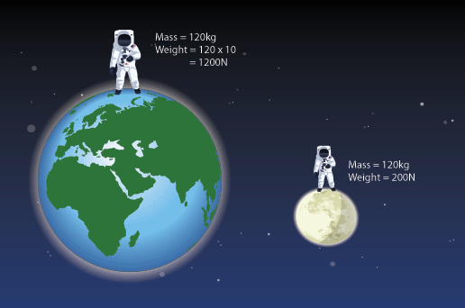
Daily Review
CFU 1
Is the mass of the two objects different?
Comparing Gravity
Consider the mass of the objects: more mass = more gravity
Consider the mass of the planets: more mass = more gravity
Consider the distance between the objects: more distance = less gravity
State which object is pulled more (or less) by gravity and explain why.
CFU 2
Is the mass of the two planets different?
CFU 3
Is the distance between the two objects different?
Vocabulary
mass (noun) the amount of matter (‘stuff’) an object contains gravity (noun) a non-contact force that pulls objects with mass together
The ________ is pulled ____ by gravity because…

Slide 6
Daily Review
CFU 1
Is the mass of the two objects different?
Comparing Gravity
Consider the mass of the objects: more mass = more gravity
Consider the mass of the planets: more mass = more gravity
Consider the distance between the objects: more distance = less gravity
State which object is pulled more (or less) by gravity and explain why.
CFU 2
Is the mass of the two planets different?
CFU 3
Is the distance between the two objects different?
Vocabulary
mass (noun) the amount of matter (‘stuff’) an object contains gravity (noun) a non-contact force that pulls objects with mass together
The ________ is pulled ____ by gravity because…

Slide 7
Magnetism Year 7 Science

Slide 8
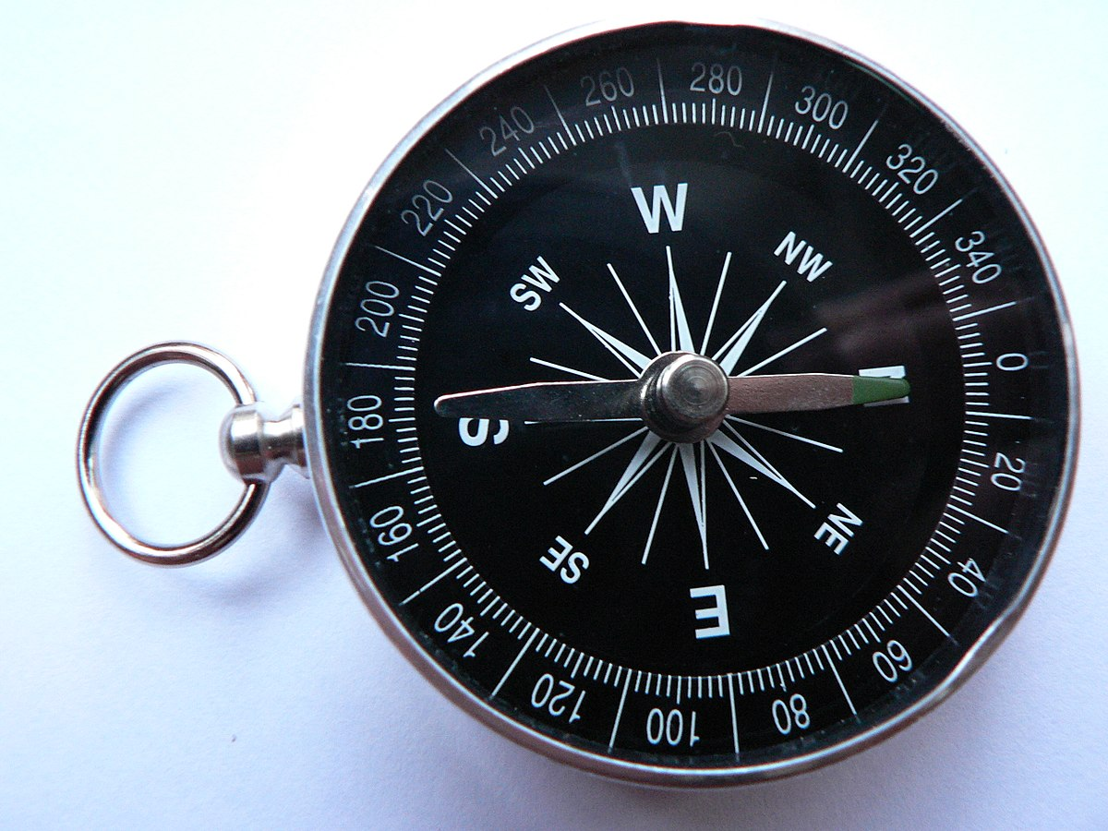
Learning Objectives
CFU
In your own words: what are we going to learn?
Describe and identify magnets and magnetic fields
Predict whether objects will be attracted or repelled by magnetism
Activate Prior Knowledge
What is this object, and what does it do?
How does it work?

Slide 9
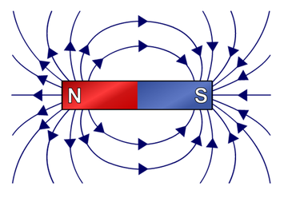
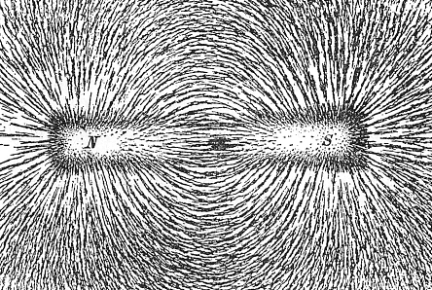
Concept Development
CFU 1
What is a magnet?
Magnets and Magnetic Fields
A magnet is something that produces a magnetic field.
Magnetic fields can:
Attract or repel other magnets
Make some metal objects into magnets, either temporarily or permanently
CFU 2
Magnets can: Repel other magnets Attract other magnets Both Neither
CFU 3
True or False: a magnet can turn a metal object into a permanent magnet.
Vocabulary
attracted (verb) pulled together repelled (verb) pushed apart

Slide 10
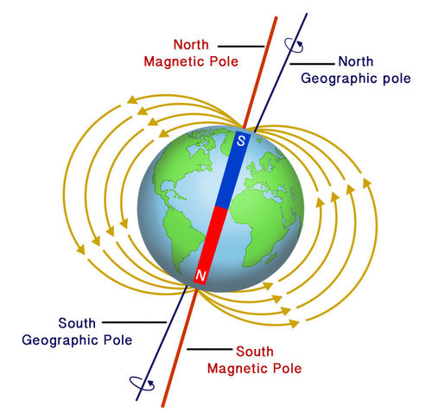
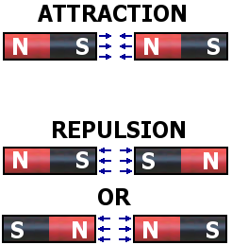
Concept Development
CFU 1
What are the names of a magnet’s two poles?
Magnetic Attraction and Repulsion
Magnets always have two poles: a north pole and a south pole.
Different (unlike) poles will be pulled towards each other (attracted).
Similar (like) poles will be pushed away from each other (repelled).
The north pole of a magnet will always turn towards the Earth’s North Pole.
CFU 2
What would happen if the north end of a magnet was held next to the south end of another magnet?
CFU 3
If the north pole of a magnet always turns to the north, is the Earth’s ‘North Pole’ a magnetic north pole or a magnetic south pole? (Hint: imagine the Earth as a ball with a giant magnet inside.)

Slide 11
As tell Bs
Bs tell As
What is a magnet
Describe what happens when like poles are placed together and what happens when opposite poles are placed together

Slide 12
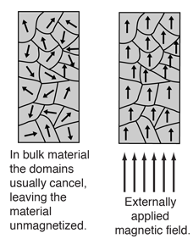
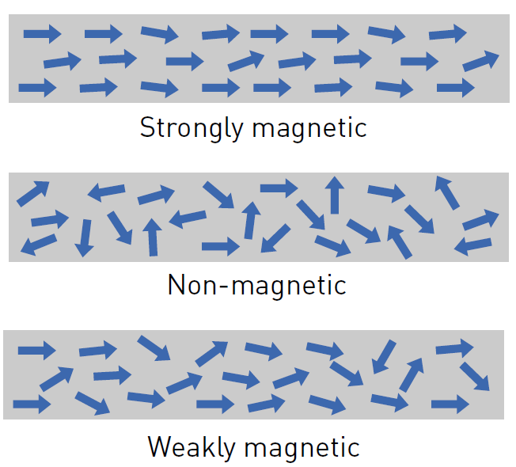
Concept Development
CFU 1
What do magnetic domains have to do with the strength of a magnet?
Magnetisation
Magnets are made up of smaller magnetic parts called magnetic domains. The better aligned these domains are, the more magnetic a material is.
Iron, nickel and cobalt have these domains, but they’re usually a mess. A magnet can straighten them out, making the metal magnetic.
If the magnet used is strong enough, the domains will stay lined up, making the metal a permanent magnet.
CFU 2
Draw and explain what you would get if you cut the strong magnet in two.
CFU 3
Which three metals have magnetic domains?
CFU 4
How can a strong magnet make a metal object into a magnet?
Vocabulary
magnetic domain a small part of a magnet or magnetic material

Slide 13
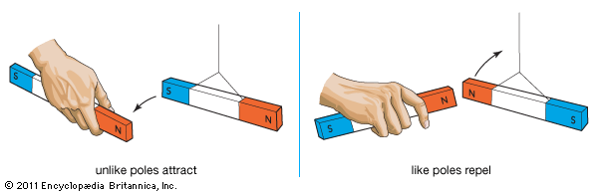
Skill Development / Guided Practice
CFU 1
Which two poles are near each other?
Predicting Magnetism
Predict what will happen
Different poles are attracted
Similar poles are repelled
Iron, nickel and cobalt objects will be magnetised and attracted to any magnet
Explain why it will happen
The two magnets will be ________ because…
CFU 2
What is going to happen to the two magnets, and why?

Slide 14
Skill Development / Guided Practice
CFU 1
Which two poles are near each other?
Predicting Magnetism
Predict what will happen
Different poles are attracted
Similar poles are repelled
Iron, nickel and cobalt objects will be magnetised and attracted to any magnet
Explain why it will happen
The two magnets will be ________ because…
CFU 2
What is going to happen to the two magnets, and why?

Slide 15
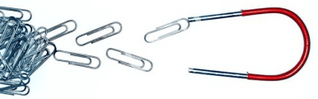
Skill Development / Guided Practice
CFU 1
Are there two magnets in this picture?
Predicting Magnetism
Predict what will happen
Different poles are attracted
Similar poles are repelled
Iron, nickel and cobalt objects will be magnetised and attracted to any magnet
Explain why it will happen
CFU 2
What is going to happen to the two objects, and why?

Slide 16
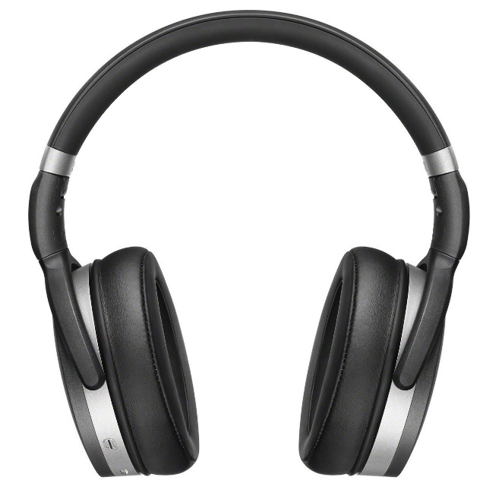
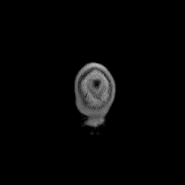
Relevance
Magnets are used in:
Compasses
Speakers
Microphones
Computer hard disk drives
MRI (magnetic resonance imaging) scanners, which are used to diagnose brain cancers, dementia, epilepsy, and much more.

Slide 17
Skill Closure
Fill in the blanks: poles can be ________ or ________. The same poles are ________; different poles are ________.
Which of the metals below are magnetic?
Iron, Aluminium, Steel, Copper, Gold, Nickel
3. Describe what would happen in each of the following situations and explain why.
Lilly tries to push the south ends of two magnets together.
Craig holds a magnet over an iron nail.
Alice holds the north end of a magnet near the south end of another magnet.
Reminders:
Different poles are attracted Similar poles are repelled Iron, nickel and cobalt objects will be magnetised and attracted to any magnet

Slide 18
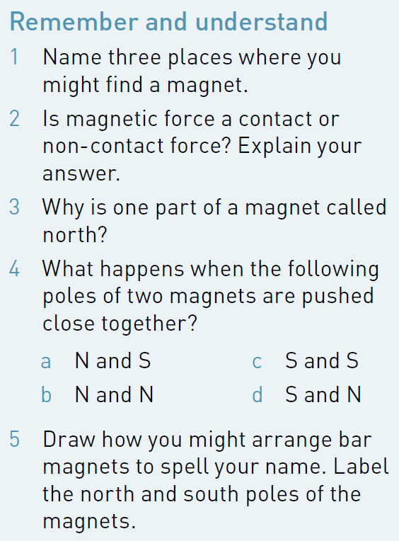
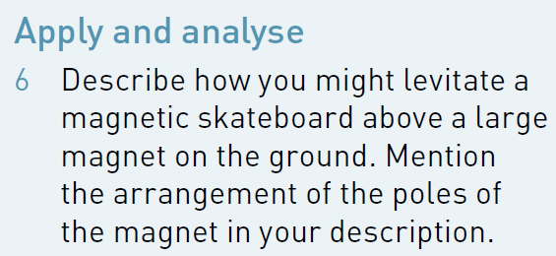
Independent Practice
Complete Questions 1-6 on p. 125 of your textbook.
Reminders:
Different poles are attracted Similar poles are repelled Iron, nickel and cobalt objects will be magnetised and attracted to any magnet

